Slide 1


CPCESU Project
Management System
Design Review 2
+
Joseph Remy [Team Lead], Colton Nunley, Jasque Saydyk
Faculty Mentor: Ana Paula Chaves Steinmacher
Notes:
[Colton]
15 seconds
Questions for presentation:
Gantt chart, show to end of project or is current fine? Or have another with a much bigger view of project with just milestones, then

Slide 2
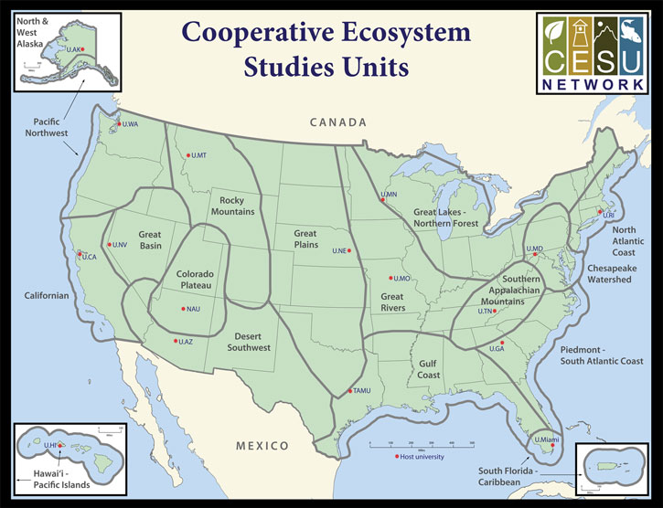
Colorado Plateau Cooperative Ecosystem Studies Unit
CPCESU is a part of a national consortium for resource stewardship
  Dozens of projects
  Hundreds of modifications
  Millions of dollars
Notes:
[Colton]
30 seconds
Hook/Big picture
Nature is very important part of who we are as humans. It is our foundational responsibility to be stewards of mother nature. This planet is our home...
CPCESU
The Colorado plateau fosters this love and stewardship by supporting and maintaining ecological projects across the SW. They act as an intermediary between various Federal and non federal agencies to provide project projection and statistics as well as maintain current projects with what they refer to as ‘modifications’.
Specifics
To do this, the Colorado Plateau gets dozens of project proposals, hundreds of modifications, and millions of dollars each year to setup, organize, fund, track, and archive these projects. They accomplish this by utilizing data from past projects. Their current project management system is hindering their ability to work effectively.
The CPCESU is a government agency which organizes federal agencies and Native, state, and local governments with non-governmental organizations and universities to complete a variety of conservation projects from investigating archeology sites to conducting zoological surveys.
All of this helps preserve the nature and history of the Amercian Southwest, allowing us to learn more about the impacts we have our fragile ecosystem<move up wide to specfic>
To do this, the CPCESU gets dozens of project proposals, hundreds of modifications, and millions of dollars each year to setup, organize, fund, track, and archive these projects.
Which is common thing for organizations to do, and each organization is going to have their own system to manage their projects, whether it’s formalized or not
The CPCESU is a part of a national consortium that is focused on assisting organizations, like the National Park Service and the Bureau of Land Management, draft projects to be done by university professors and students, connecting these organizations with subject matter experts if need be, and providing a legal contract stating how these projects are to be completed, tracking these projects until they are completed, and transferring the funding for these projects over from the organization to the budget for the project.
This is something that a bunch of organizations do, make take projects, assign them, and track them throughout their lifetime, given them a budget to work with, and each of their management schemes cater their particular needs and niches. Even we in software dev use other tools to help us track the projects we are working on
Old Rough Slide content:
Colorado Platue Coorperative Ecosystem Studies UnitIn they help connect federal agencies and organizations that want to have a project that does a ecological studies etc, with experts for various projects and connect them, establishes a contract between the two, distributes funds accordingly, and tracks the project throughout it’s life
CPCESU:
The CPCESU is a derivative of the CESU which a national organization which is spread among many different biogeographical areas of the US. The CPCESU is hosted by NAU with Dr. Todd Chaudhry as the Research Coordinator and Laurie Thom as the Program Coordinator. They are going to be the main users for our end product. Both of them help many different federal agencies come up with a viable ecological project plans based on past project experience and statistics. The Colorado Plateau helps other federal agencies work on ecological projects. Whether that's studies, help building and maintaining a trail, or ecological investigations.

Slide 3




Current Technology
Notes:
[Colton]
30 seconds
Since their founding, they have used an off-the-cuff approach to project management using
Email to setup and update the projects
Microsoft Excel to track the projects
Microsoft Access database to archive the projects
Shared file system to store the documents of the projects

Slide 4
Project Workflow
Proposal
Federal agency starts inquiry to non-government contractor
Acceptance
Both parties sign and work begins
Termination
Parties end project. Final report is created
Drafting
Proposal is passed back and forth
Tracking
CPCESU tracks project including modifications
Reporting
Project archived and used for statistics and reporting
Notes:
[Remy]
= Using techs, this is their current project workflow at a glance<pause>
= First fed agency proposes a new project and a non-federal organization is found
= The contract is drafted and passed back and forth between fed, non-fed, and CPCESU till it is final
= Once the contract is signed by both fed and non-gov parties, work starts
= Our client tracks the project including any modifications
= Once a project is terminated, a final report is created by non-fed org and shared with fed agency and Colorado Plateau
= Lastly, the project is archived and used for reporting <end>

Slide 5
Problems
Proposal
Allow organizations to Submit proposals
Acceptance
Notify work has started
Termination
Archive projects
Drafting
Validate information on the contract
Tracking
Track and Modify projects
Reporting
Distribute information to management and public
Notes:
[Remy]
= From the current project management system, we have summarized the problems at each step into one or two words each<pause>
= Overall tracking the projects, especially modifications, are the crux of our client’s problems (shown in yellow)
= Modifications are usually adding or removing time, money, and/or personnel
= The biggest problem is tens of millions of dollars going unreported due to bad tracking and reporting
= Instead of reporting to NAU 50% overhead, there’s only a 17.5% indirect rate
= This can impact whether or not NAU wants to host the organization in the future

Slide 6
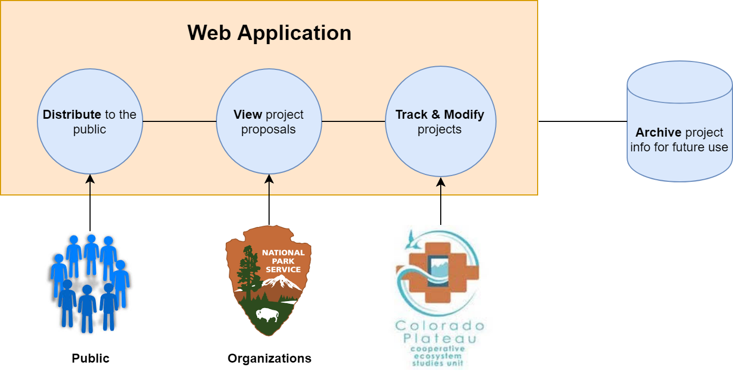
Solution - “Summit”
Notes:
[Colton]
30 seconds - 1 minute
The solution will be a secure web application built with Django with a PostgreSQL database that will track projects throughout their lifetime, archiving them when they are closed and disallowing edits to them
Hosted on its
Note web framework
!!!!!!!!!!!!!!!!!!!!!!!!!!!!!!Number the slides!!!!!!!!!!!!!!!!!!!!!
Key words to solve the various stakeholder problems
Where in solution addressing key works in previous slide
Should be clear in mapping the problem to the solution with keywords

Slide 7
Key Requirements
Track and modify projects
Notified of project deadlines
Ensure correct data
Autofill from a document
Export data from searches
Public searching through projects
Notes:
[Jasque]
As a <user type>, I want <some goal> so that <some reason>
I understand, at a glance, what the project status is
Database stays updated
common errors are not made
I don’t have to type in all of the data
I can inform organizations what they have done and to report to upper management

Slide 8
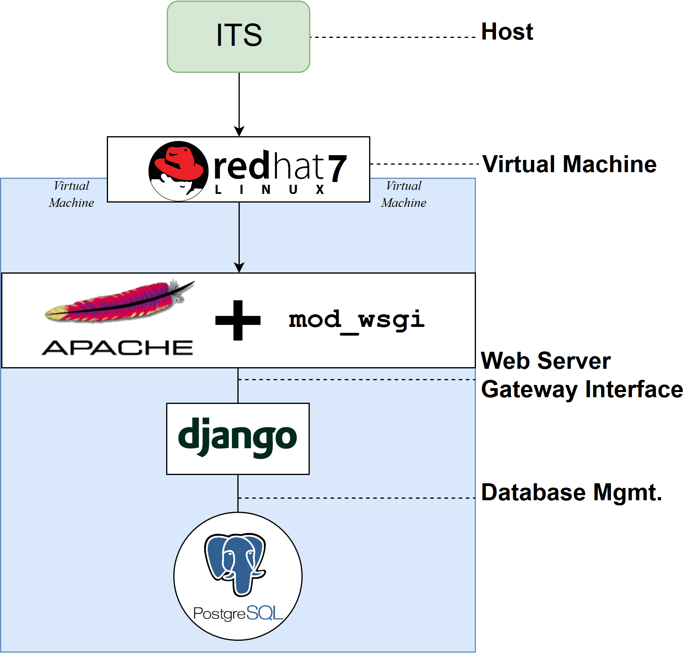
Solution System Diagram
Notes:
[Colton]
30 seconds - 1 minute
Talk more to why we chose the technologies that we did
Update diagram with new font

Slide 9
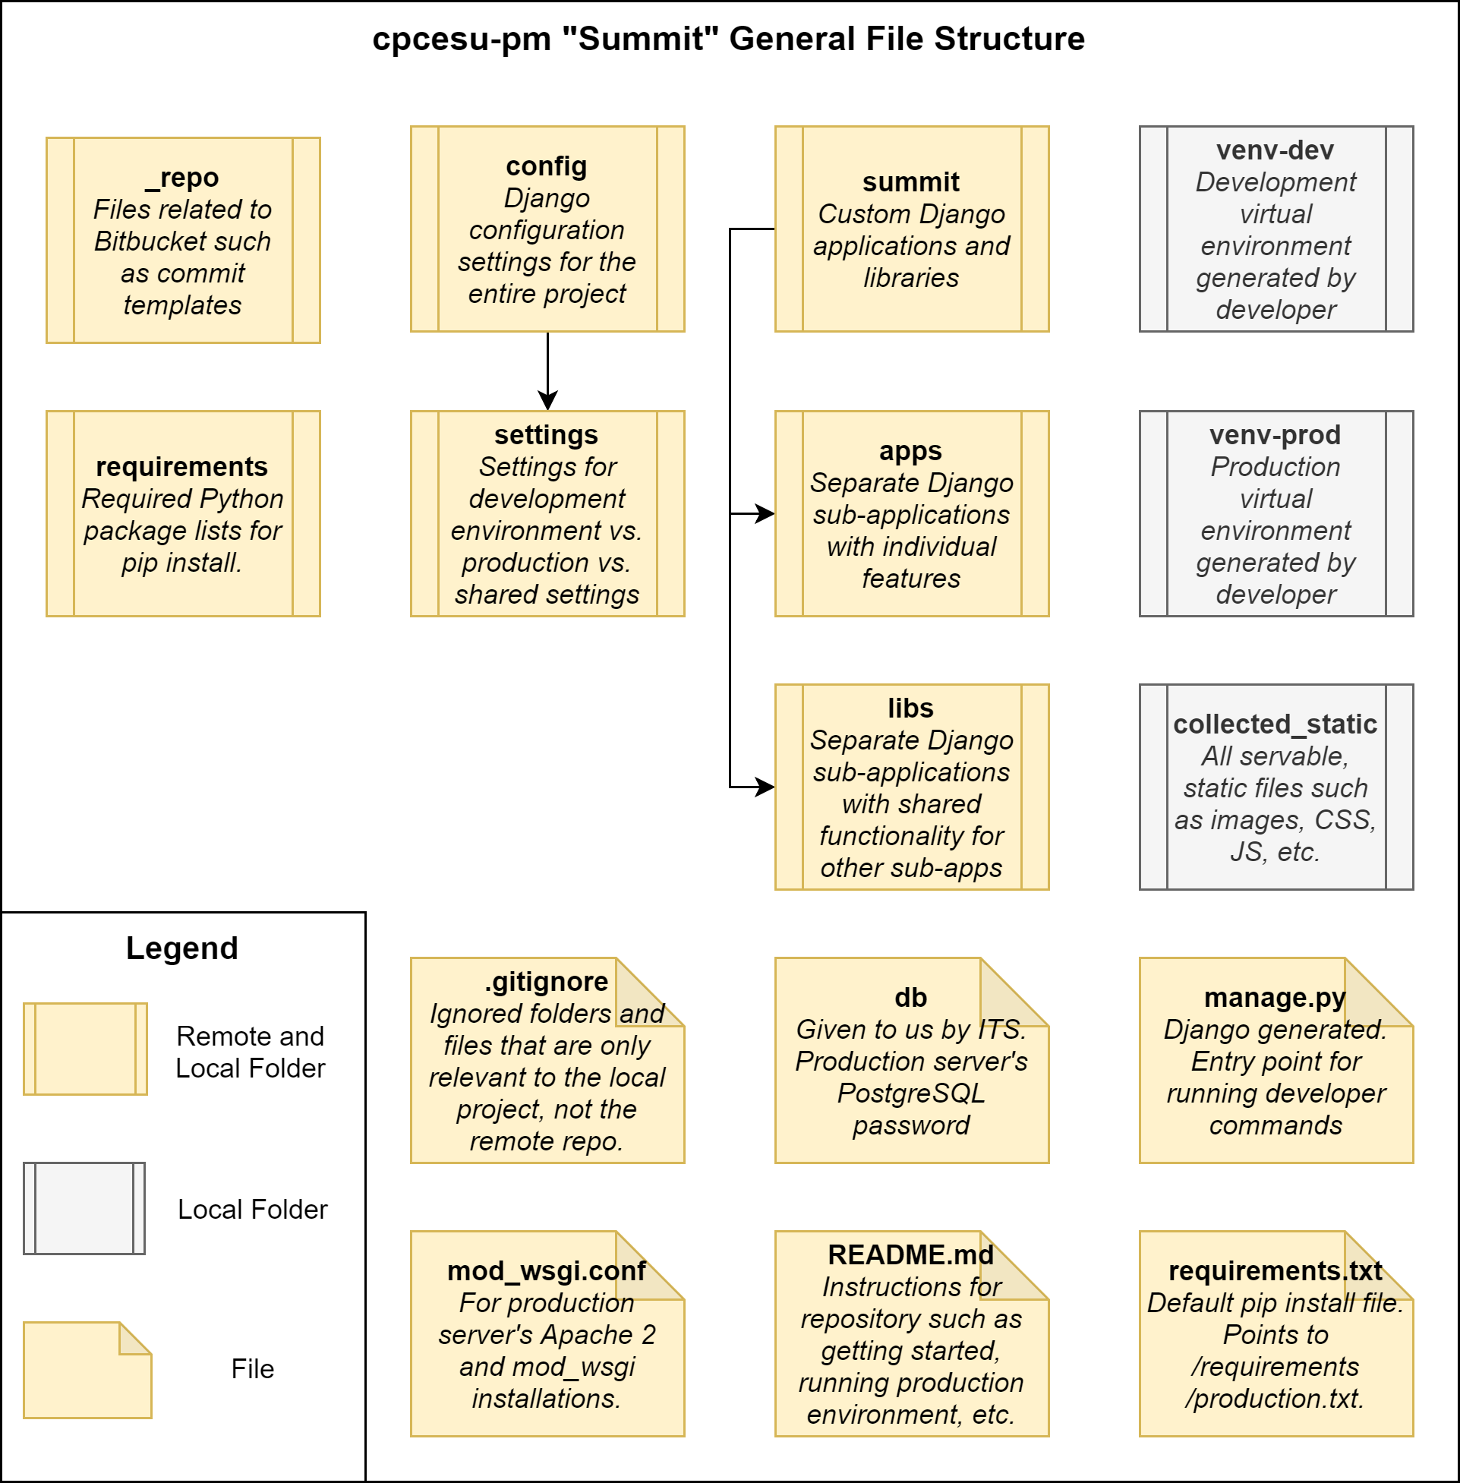
File System Tree
cpcesu-pm “Summit” General File Structure
Notes:
[Joseph]
A major part of our project is how we’ve organized it.
Project root folder structure at a glance
1st and 2nd columns are for configuration of the repo, the Django project, and Python dependencies.
3rd column is where the meat of the project exists as applications and custom and 3rd party libraries
Last column are automatically generated folders for run time using Django and our own custom commands
Lastly, yellow = stored locally and remotely as Git repo, gray is specific to the local folder (not uploaded by .gitignore rules)

Slide 10
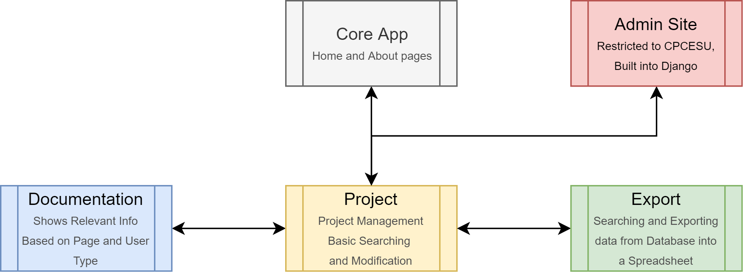
Modular App Design
Each app is connected via Python imports and URL configurations
Notes:
[Colton]
30 seconds - 1 minute
We dont have a flat “one app” for the whole project, we divided into different applications and libraries. And each app will have its own separate MVC that is linked together by urls.py
Work in tandem without having to rely on each other for functionality

Slide 11
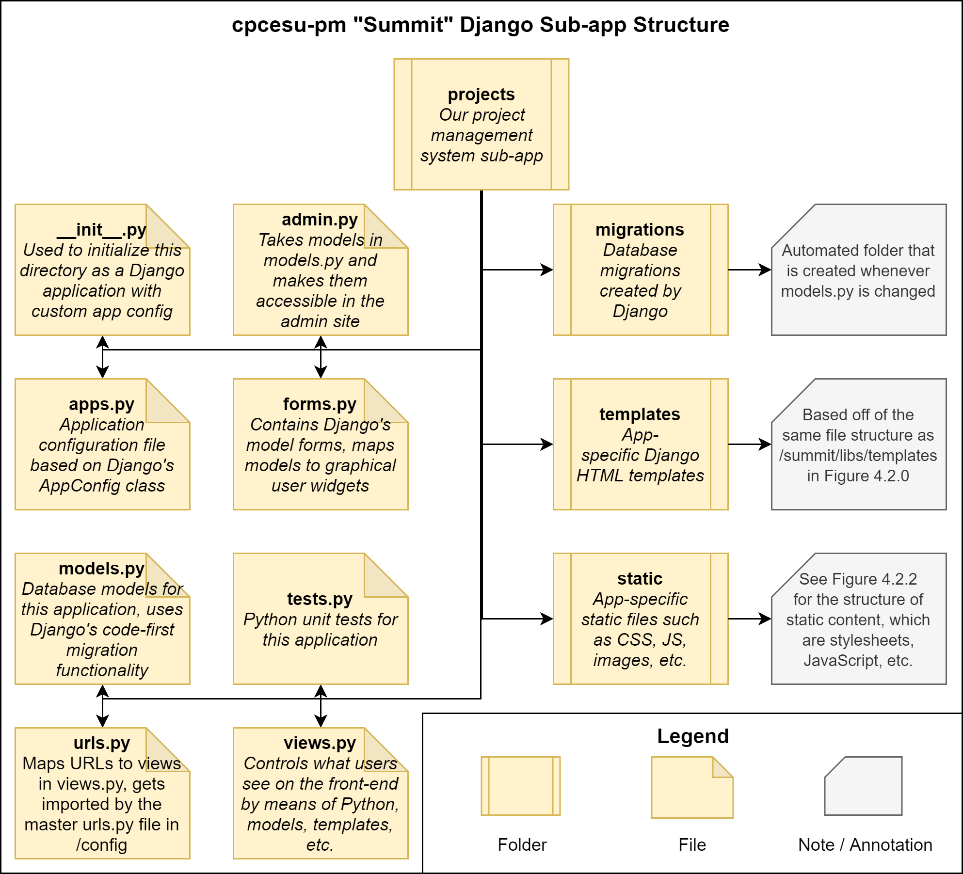
Sub-application Structure
Ex: the projects app.
Figure taken from Software Design v1.0 (Fig 4.2.1, pg. 16)
Notes:
[Joseph]
One of the key modules is our project management application called “projects.” The file tree is shown here.
The left 2 columns are all files generated by Django when you first create a sub application.
And each part contributes to the Model-View-Controller or MVC paradigm in one form or another.
Ex: forms.py and views.py both contribute to the View aspect of MVC
The right side has 3 folders, all of which contain code-first database migrations managed by Django, HTML templates for views, and any static or fixed servable files for the user such as stylesheets, JavaScripts, logos, etc. respectively

Slide 12
A Few Core Sub-app. Files
Ex: the projects app.
summit/apps/projects folder
models.py | urls.py | views.py
Database Models | Route Controller | Generating Views
Project Modification Revision | Index “/projects” Add Project “/projects/add” Project Details: “/projects/detail/<id>” Edit Project: “/projects/edit/<id>” | Index - List View “templates/index.html” Add Project - Create View “templates/project_create.html” Project Details - Detail View “templates/project_list.html” Edit Project - Update View “templates/project_update.html”
Notes:
[Joseph]
Now, a more in-depth look at our core files for the projects app.
In our models.py (first column) is our database models. Project is self-explanatory with supporting Modification and Revision history models for projects.
Urls.py (second column) is our routing controller to our different front-end views. Example: for the projects’ app’s index, we use “/projects”
In the last column, views.py covers the different user interfaces. Again, the example for the index is a list view of all of the projects and uses the template “index.html” in the projects app folder.

Slide 13
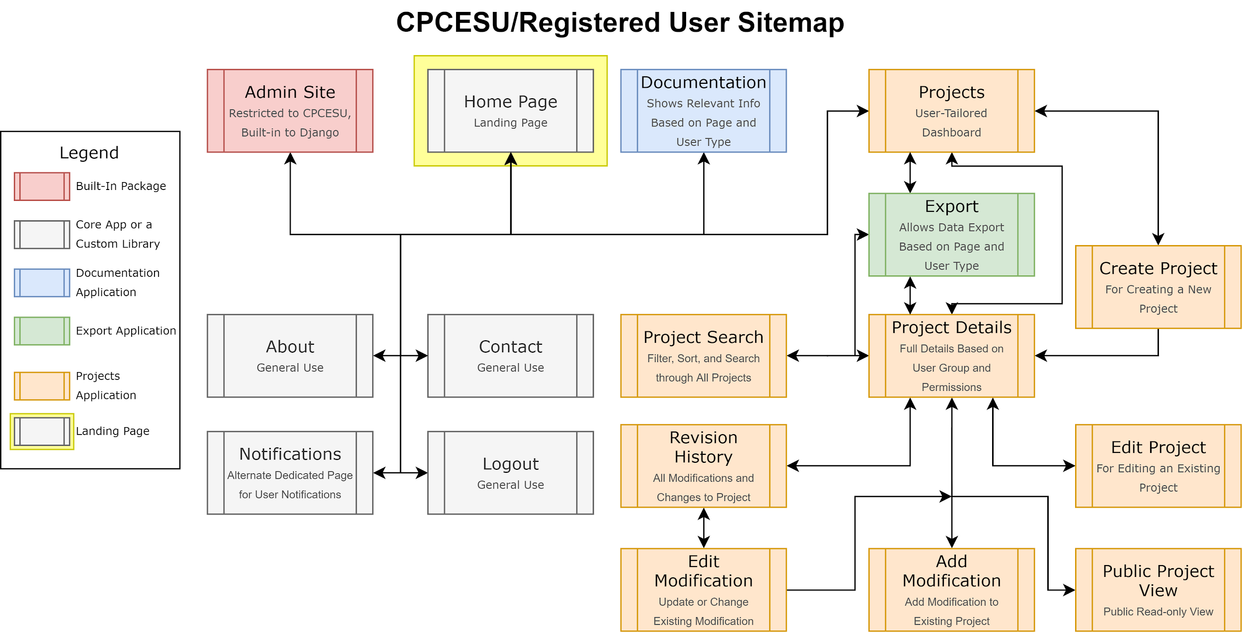
Simplified Sitemap for Authenticated Users
Notes:
[Joseph]
On this slide is the sitemap for registered users. All of the views are tied to different applications and libraries and are color coded. The connections inbetween are made by using URL configurations and user interfaces. In orange or the bottom right, we see the project application’s views.
Now the other views. On the top left in red is the admin site, built in to Django (backend management)
Right of that, there’s the home page (which is also yellow, representing the landing page for the whole project)
Next in blue is the documentation app which has symbolic links to every page you see here that has documentation
Lastly, the 4 gray pages to the bottom-left are general use such as about, contact, and so on.

Slide 14
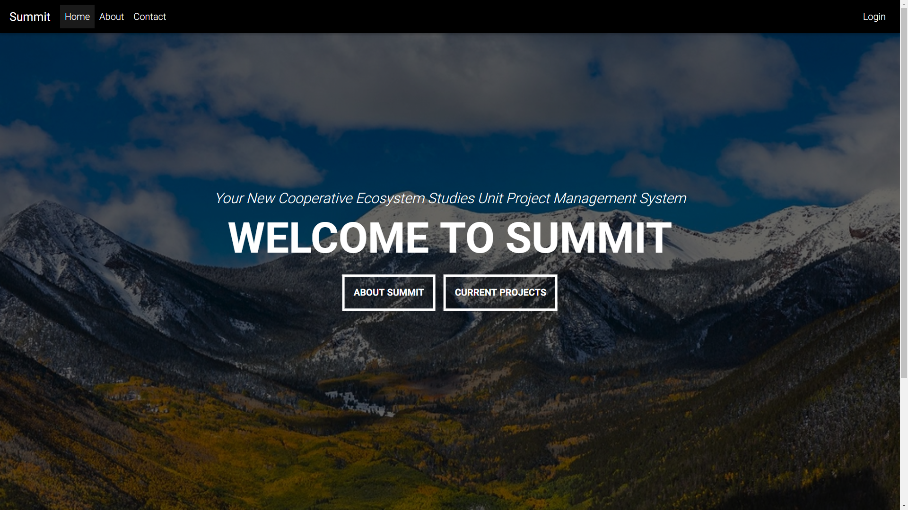
Current Status - Homepage
Notes:
[Jasque]
Federal computers

Slide 15
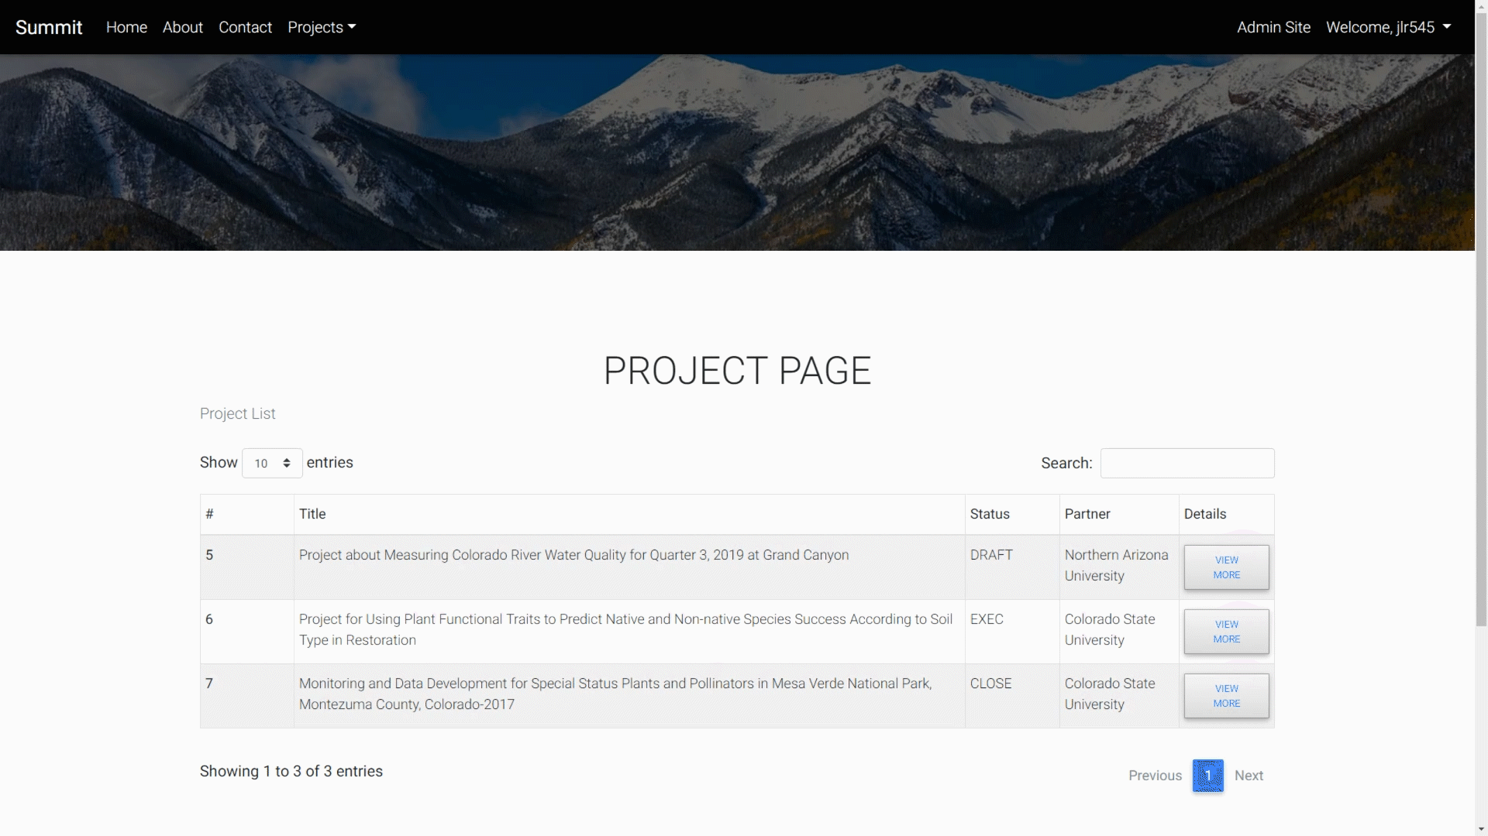
Current Status - Project List and Search
Notes:
[Jasque]
Federal computers

Slide 16
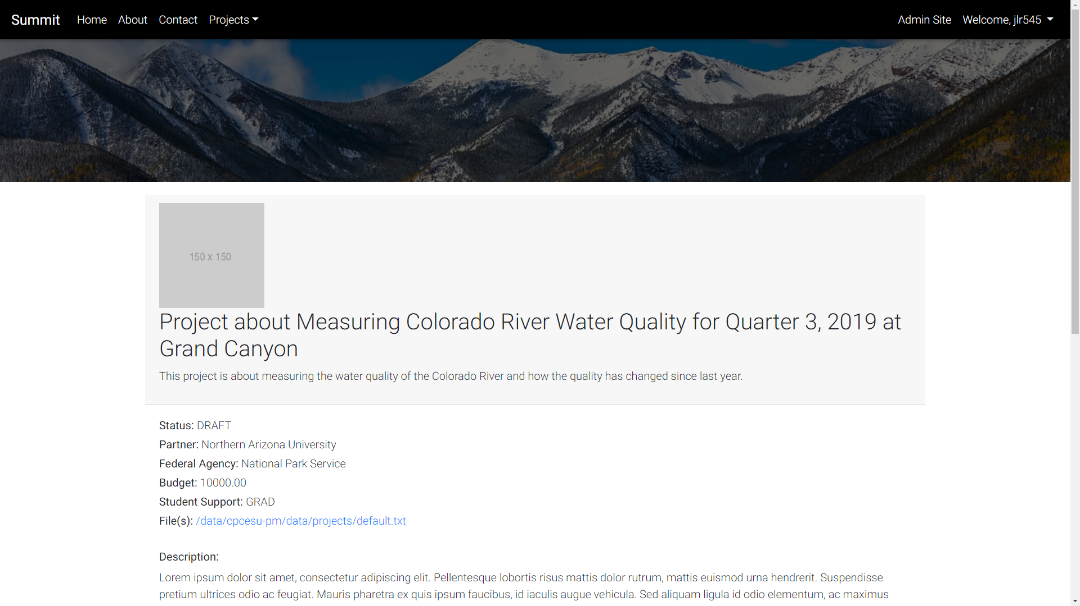
Current Status - Project Details
Notes:
[Jasque]
Federal computers

Slide 17
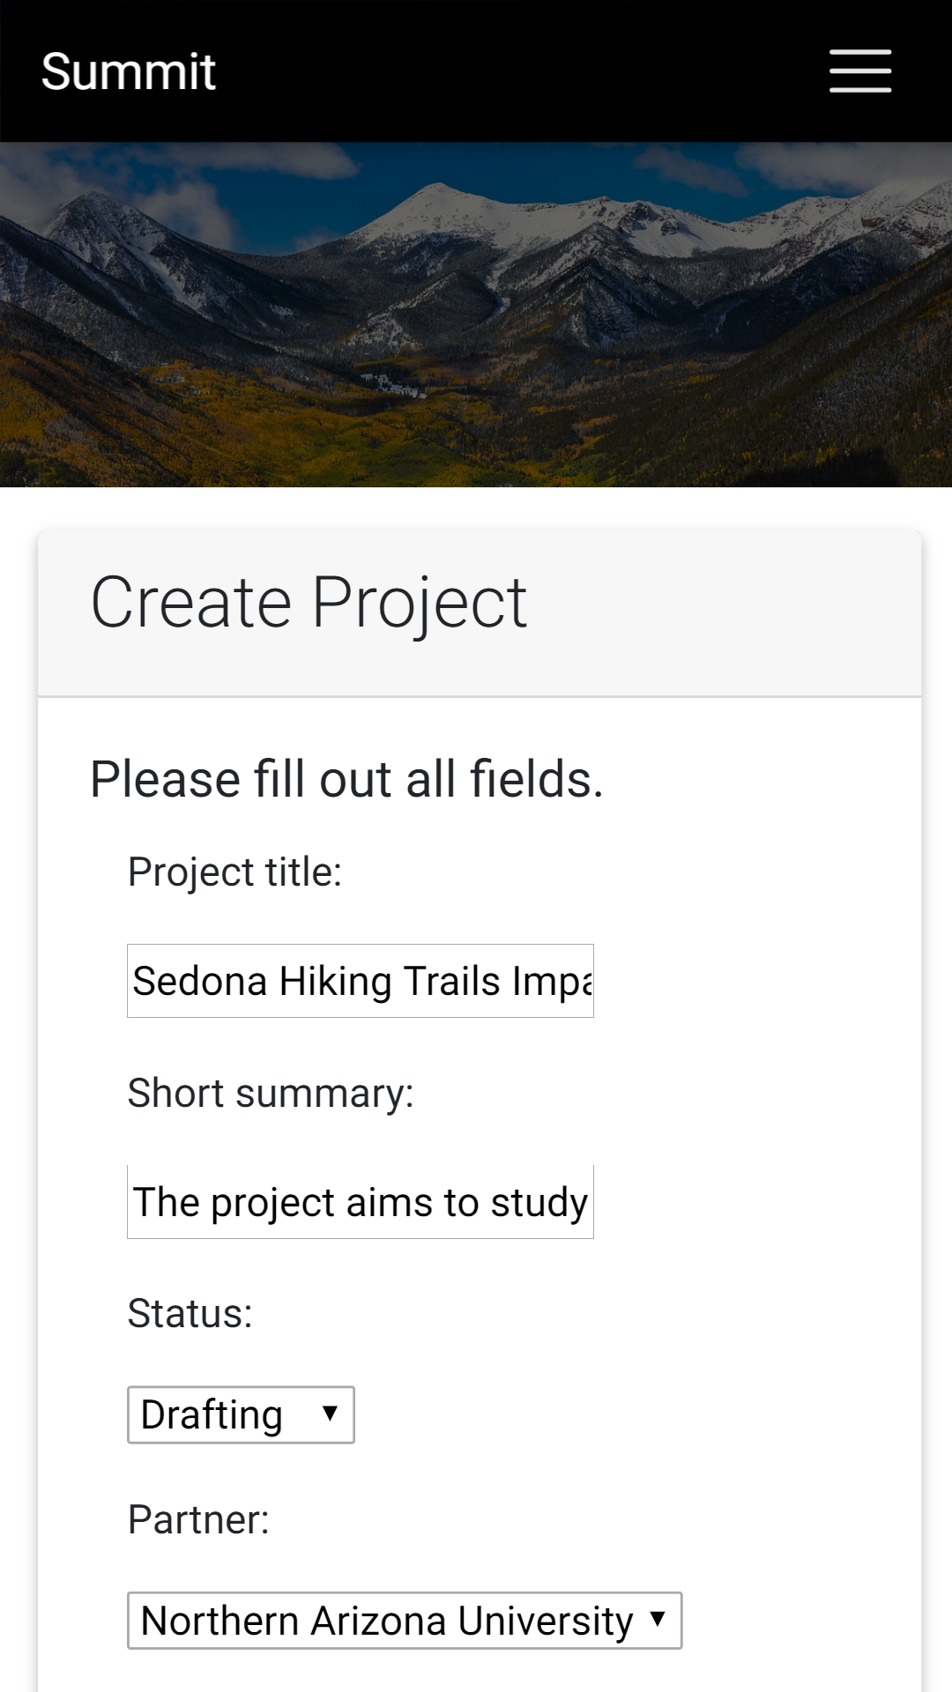
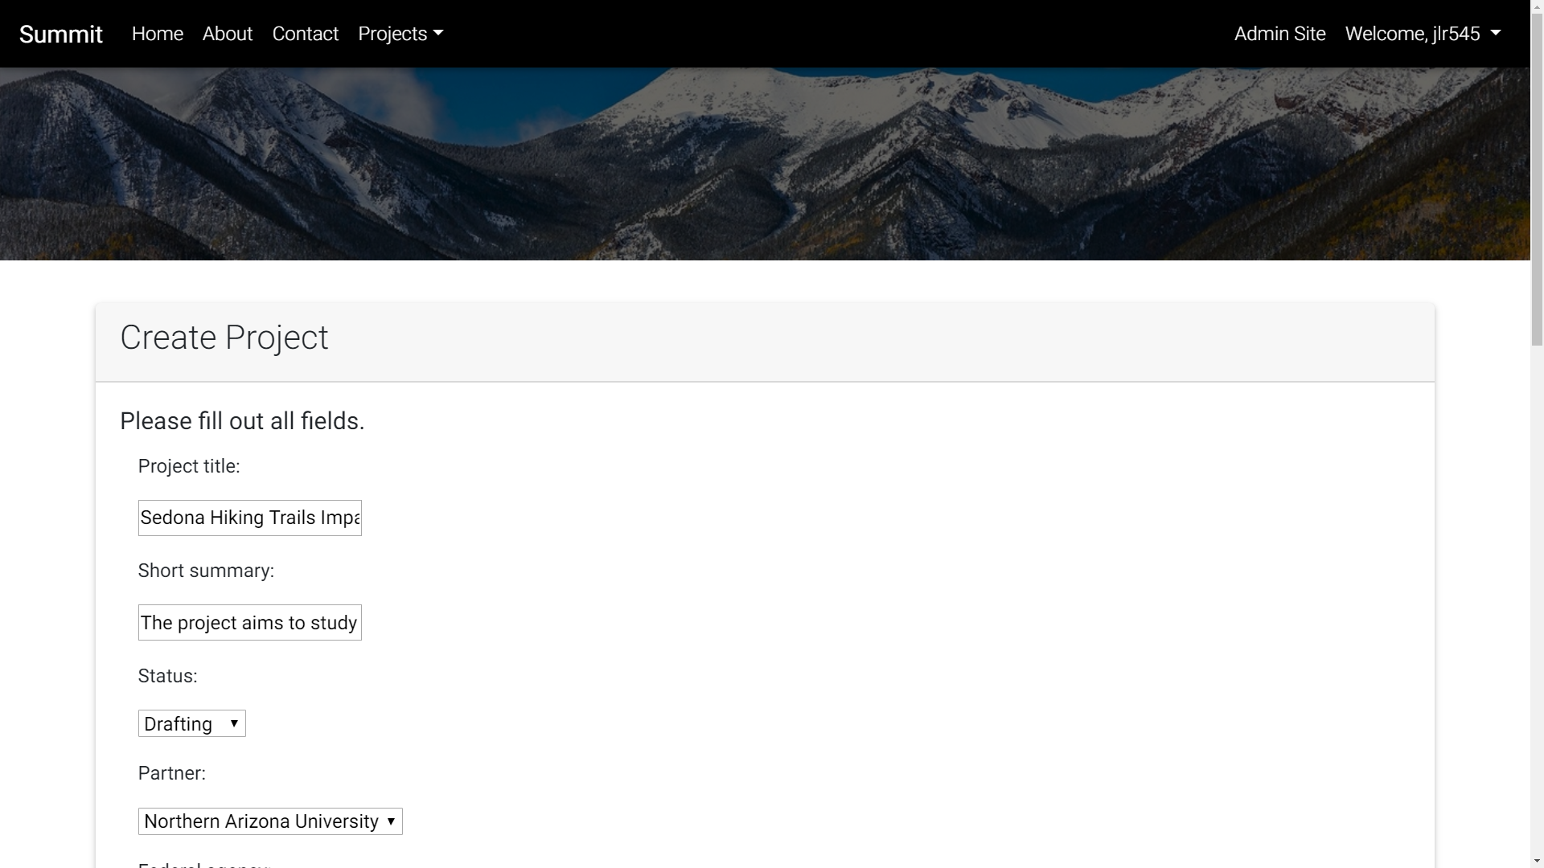
Current Status - Responsive Design
Desktop
Mobile
Notes:
[Jasque]
Federal computers

Slide 18
Challenges and Resolutions
Expectation Gap | 25% | High
  Overcome with weekly client visits
Optical Character Recognition (OCR) | 5% | Low
  Asynchronous processing using Celery
Deployment Issues | 5% | Low
  Early and constant communication with ITS
Notes:
[Jasque]
2 minutes tops - probably 1 minute
= With requirements and our tech feasibility, we have also gathered some risks
= The first is that curve is too high - 25% The potential impact = high → if this happens, our solution is not intuitive and our client may revert back.
== Use continuous integration and continuous delivery -> constantly release new versions
== Get feedback with early prototypes
= Next, common issue in software engineering is unknown or overlooked requirements - 10% - impact mid to high depending on the requirement level
== Procedures to modify the Software Requirements Specifications after it is signed
= Lastly, web app, can have security breach - 5% - mid to high → overcome with security testing
<End>

Slide 19
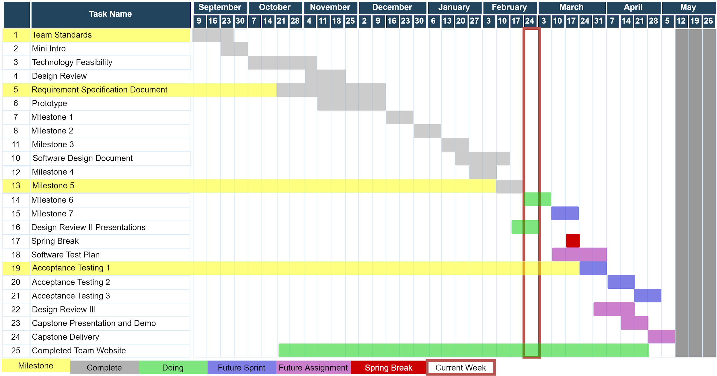
Year at a Glance
Notes:
[Jasque]
1 minute to 1:30
= in red → this week
= in yellow → personal milestones
= on the left → are the previous previous tasks, completed in grey
= in the middle → in green, are the assignments we are currently working on
= on the right → are the future tasks.
== in blue, are planned sprint items
== in purple, are future capstone assignments
<end>
Gantt chart
Explain the chart better, resize the chart
Change color, red bad,
Use red to indicate maybe a problem atm
Color green where we are
Yellow what we are doing
Grey, yet to do
Red for dead/late
3 col, duration, start, end, not useful

Slide 20
Conclusion
Notes:
[Colton]
This can be rolled out to other CPCESU’s as they also have this same problem
1:30
Take opposite of intro, funnel out from solution, problem, cpcesu, to world impact
This may become national system
So as ECOders, we’re gonna provide the CPCESU with the ability to work on things that matter, such as project statistics, and predictions to help them with future projects. They shouldn’t be wasting their time on scouring an ad hoc database.
Project management system
Project reporting, querying, and statistics
Reduce paper waste
Decrease lost work hours
Uniformed system and processes
Validation of data

Slide 21
Broader Impacts
Better reporting to NAU and other organizations
Can become the national network’s system
Aiding conservation projects and the environment
Notes:
[Colton]
15 seconds
BROADER IMPACT TO THE REST OF CPCESU
This may become national system
So as ECOders, we’re gonna provide the CPCESU with the ability to work on things that matter, such as project statistics, and predictions to help them with future projects. They shouldn’t be wasting their time on scouring an ad hoc database.
Project management system
Project reporting, querying, and statistics
Reduce paper waste
Decrease lost work hours
Uniformed system and processes
Validation of data

Slide 22


CPCESU Project
Management System
Joseph Remy | Colton Nunley | Jasque Saydyk
Team Lead Editor-in-Chief UI Designer Lead | Architect Customer Communications QA Manager | Business Analyst Recorder Release Manager
remy@nau.edu | crn79@nau.edu | jrs496@nau.edu
http://bit.ly/ECOders
Notes:
[Colton]
30 seconds top

Slide 24
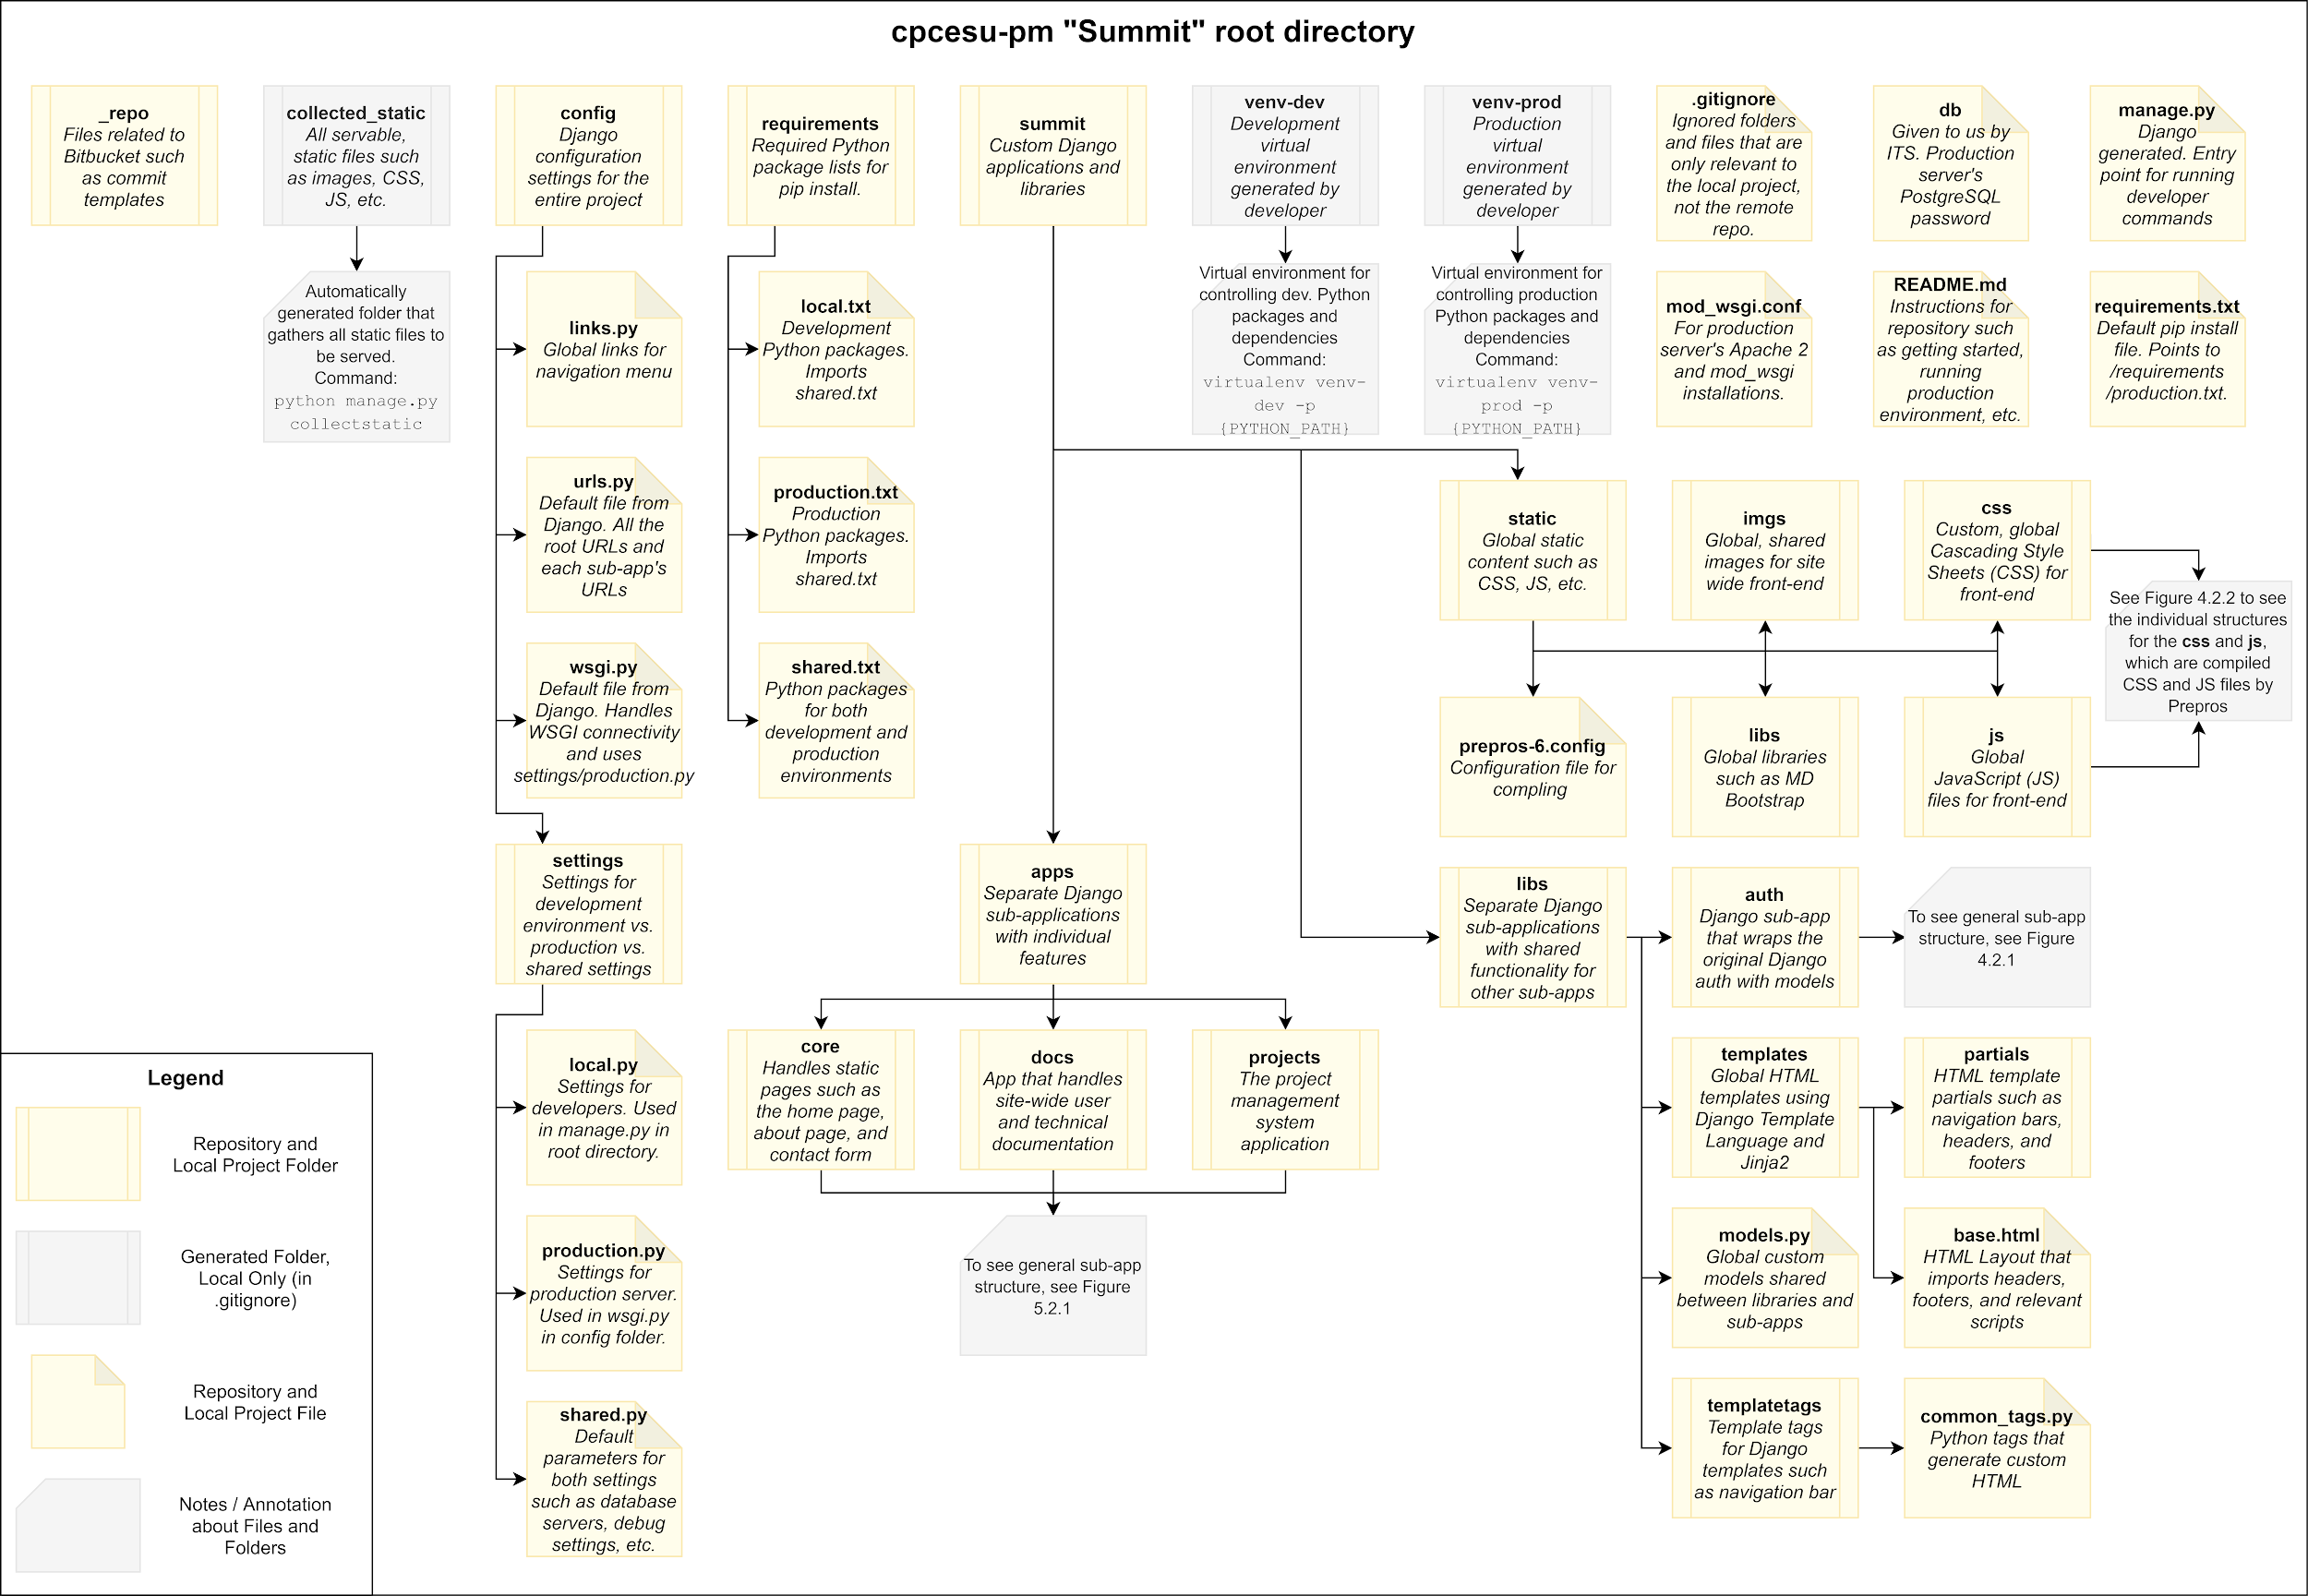
Full File Tree - Part 1 (Figure 4.2.0)

Slide 25
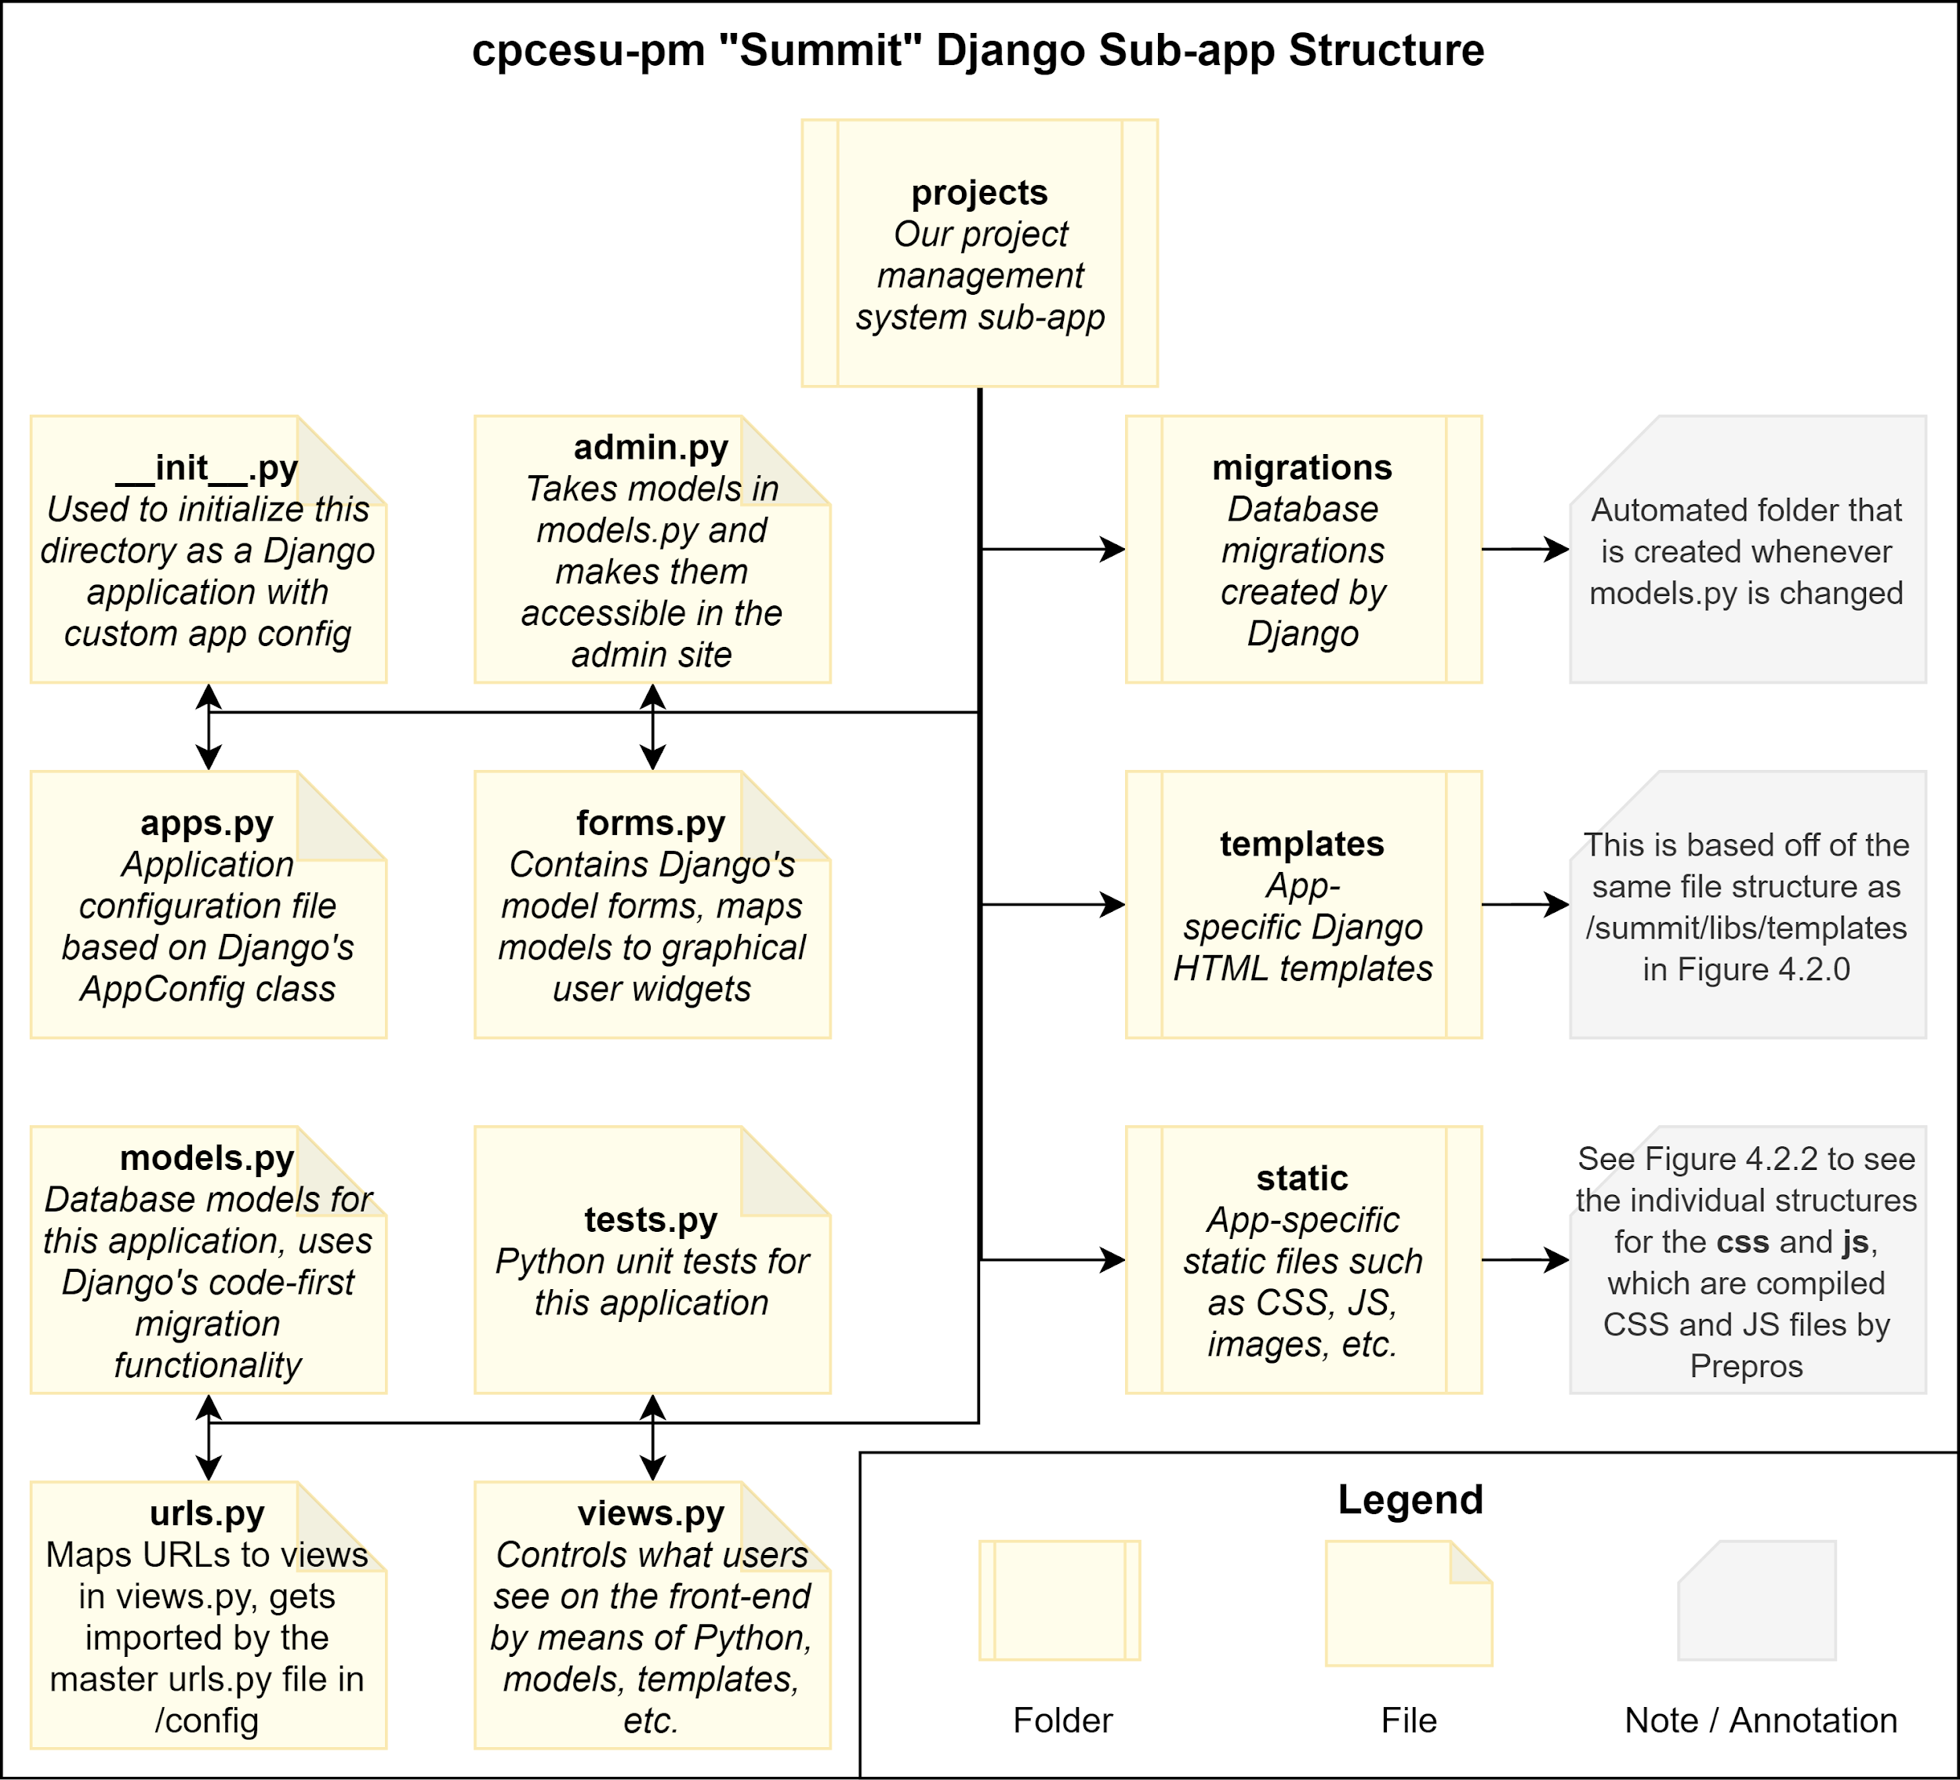
Full File Tree - Part 2 (Figure 4.2.1)

Slide 26
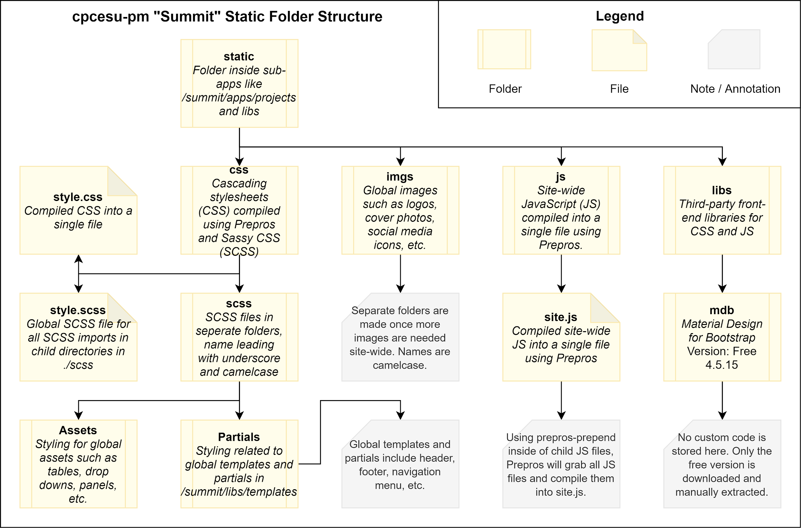
Full File Tree - Part 3 (Figure 4.2.2)

Slide 27
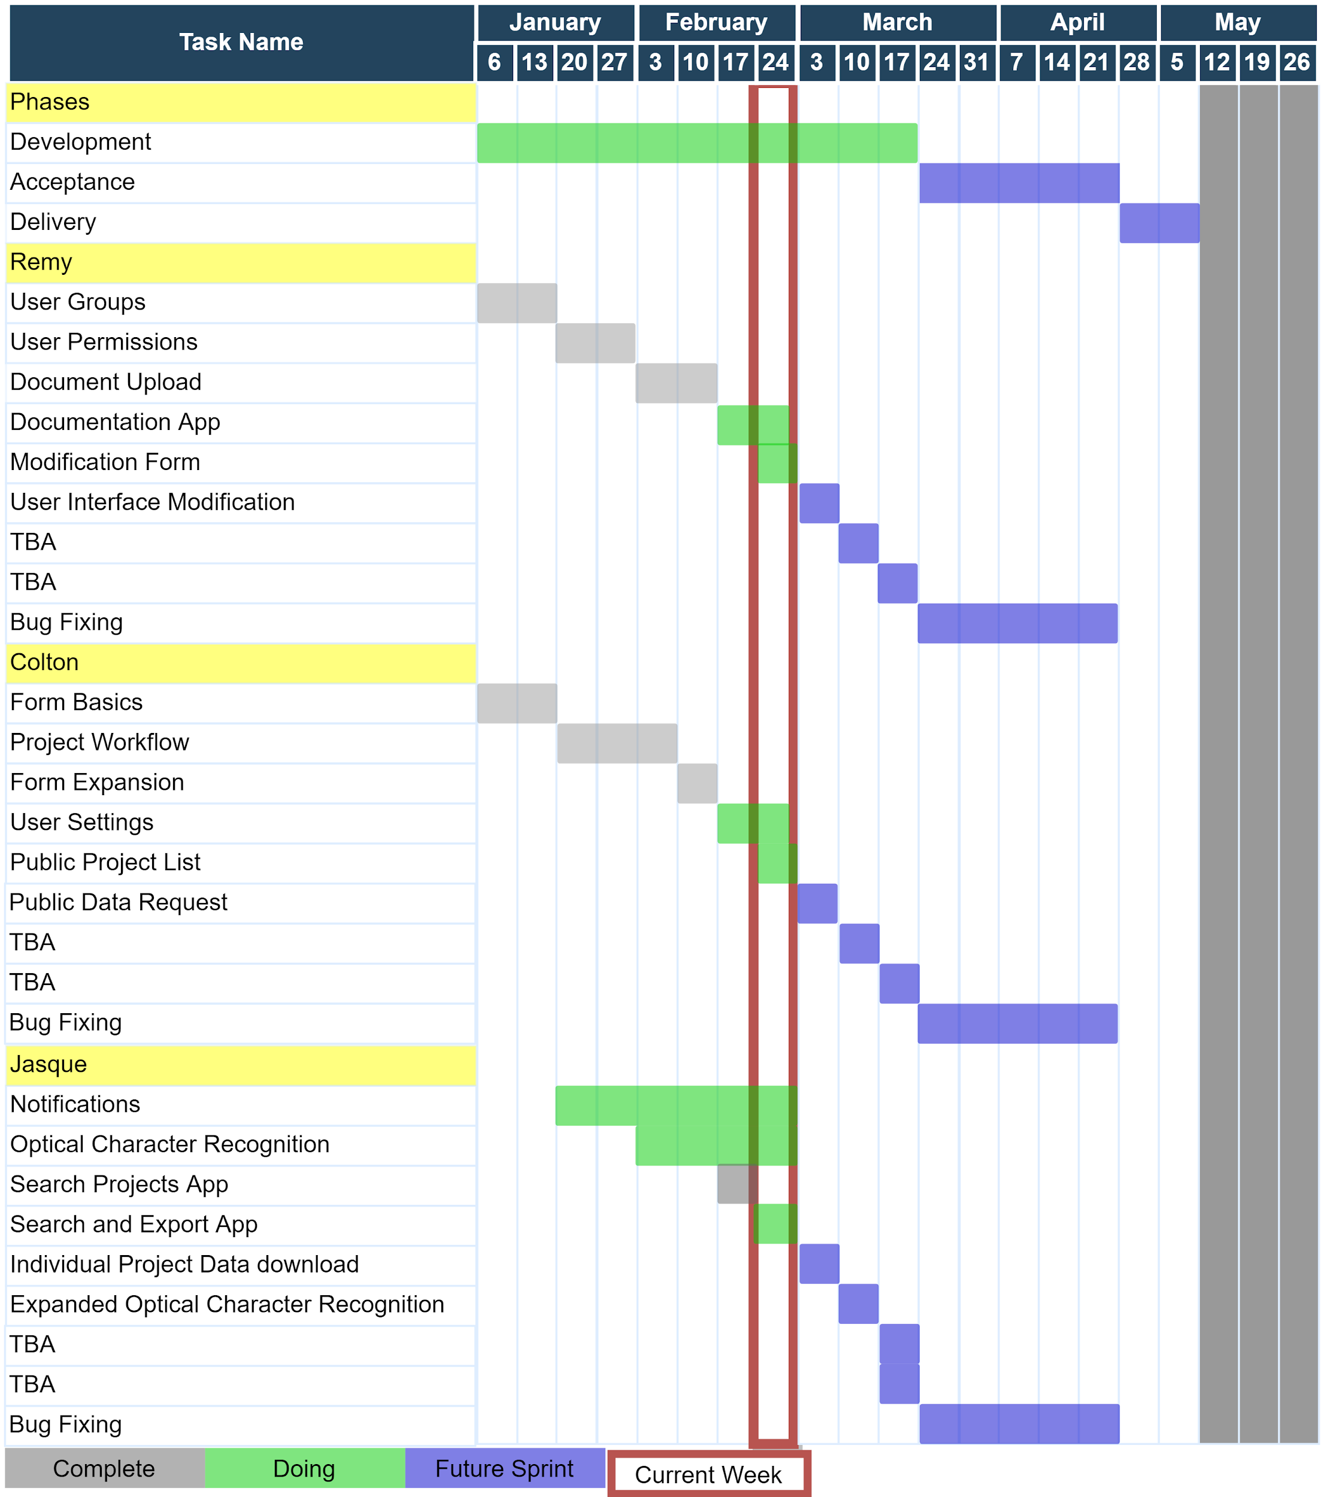
Spring Semester Schedule
Notes:
[Remy]
1 minute to 1:30
Gantt chart
Explain the chart better, resize the chart
Change color, red bad,
Use red to indicate maybe a problem atm
Color green where we are
Yellow what we are doing
Grey, yet to do
Red for dead/late
3 col, duration, start, end, not useful

Slide 28
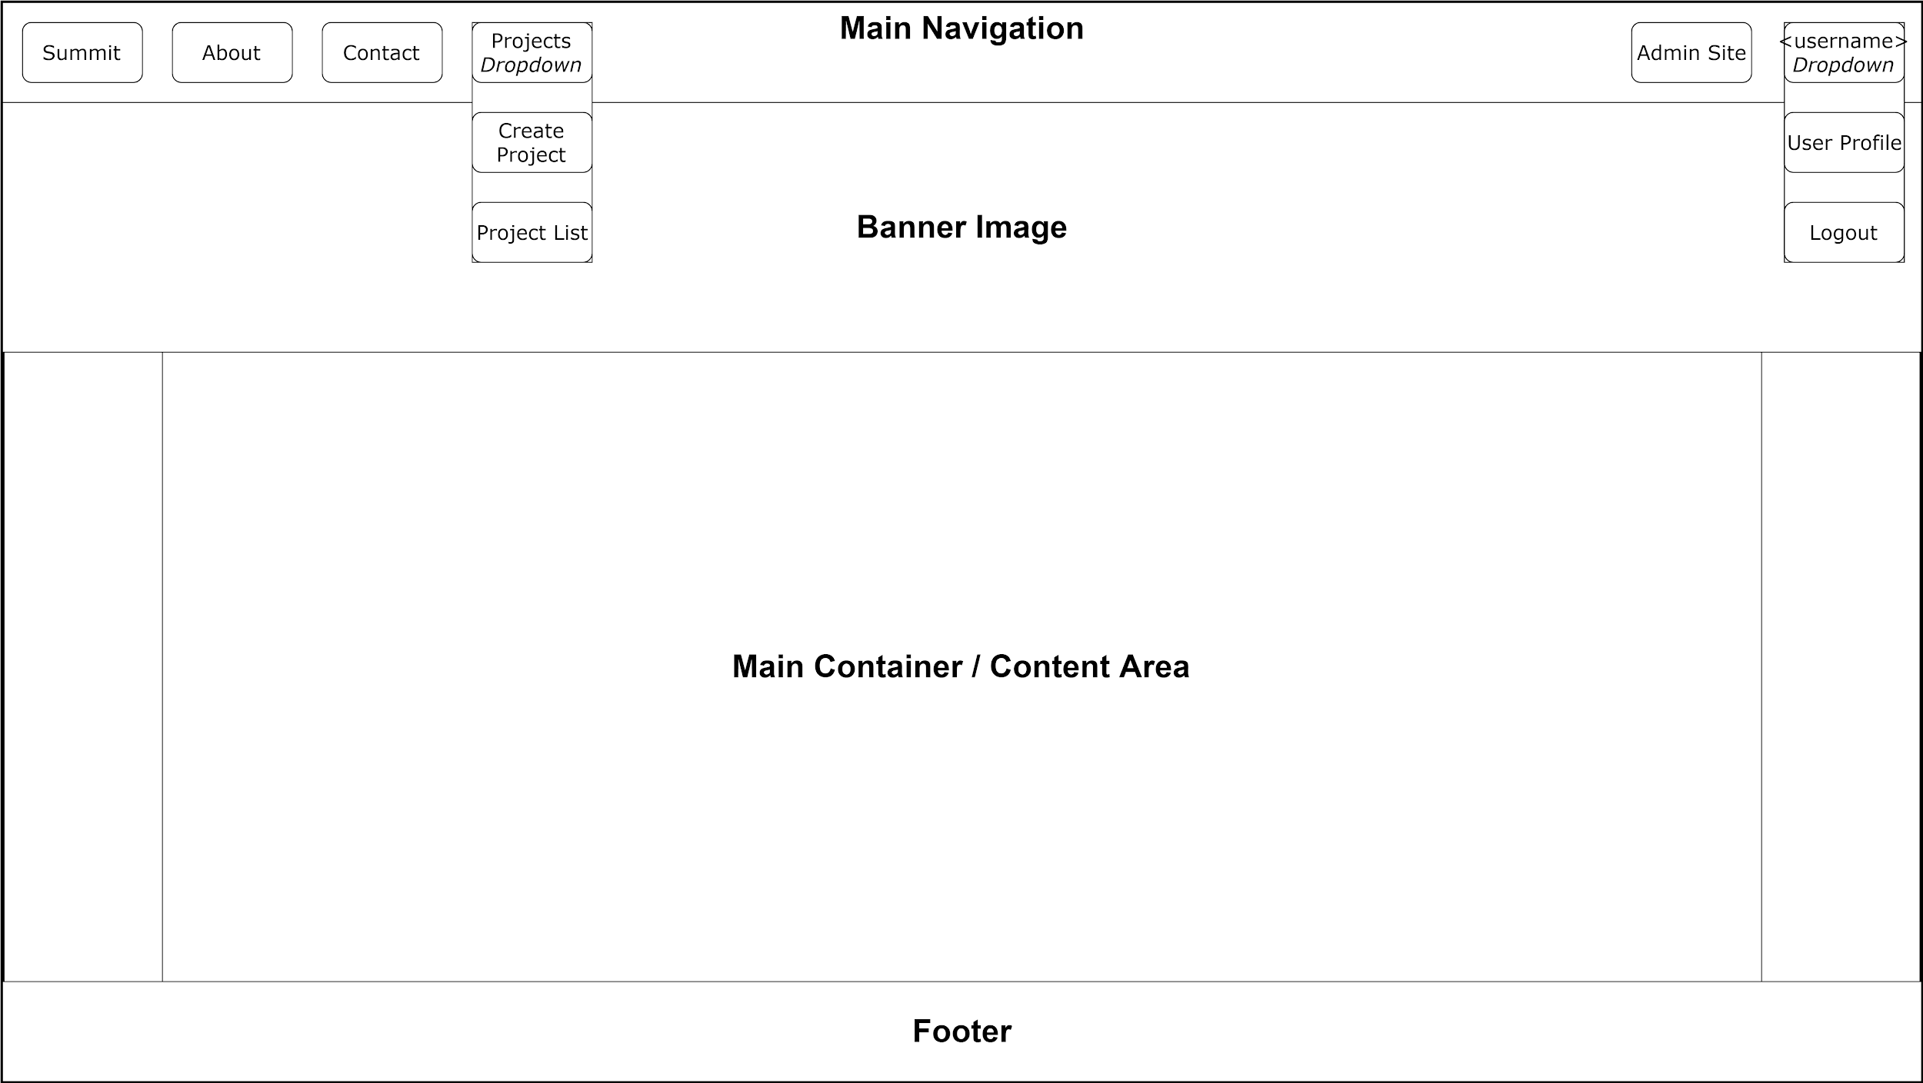
UI Mockup
Notes:
[Jasque]
Federal computers

Slide 29
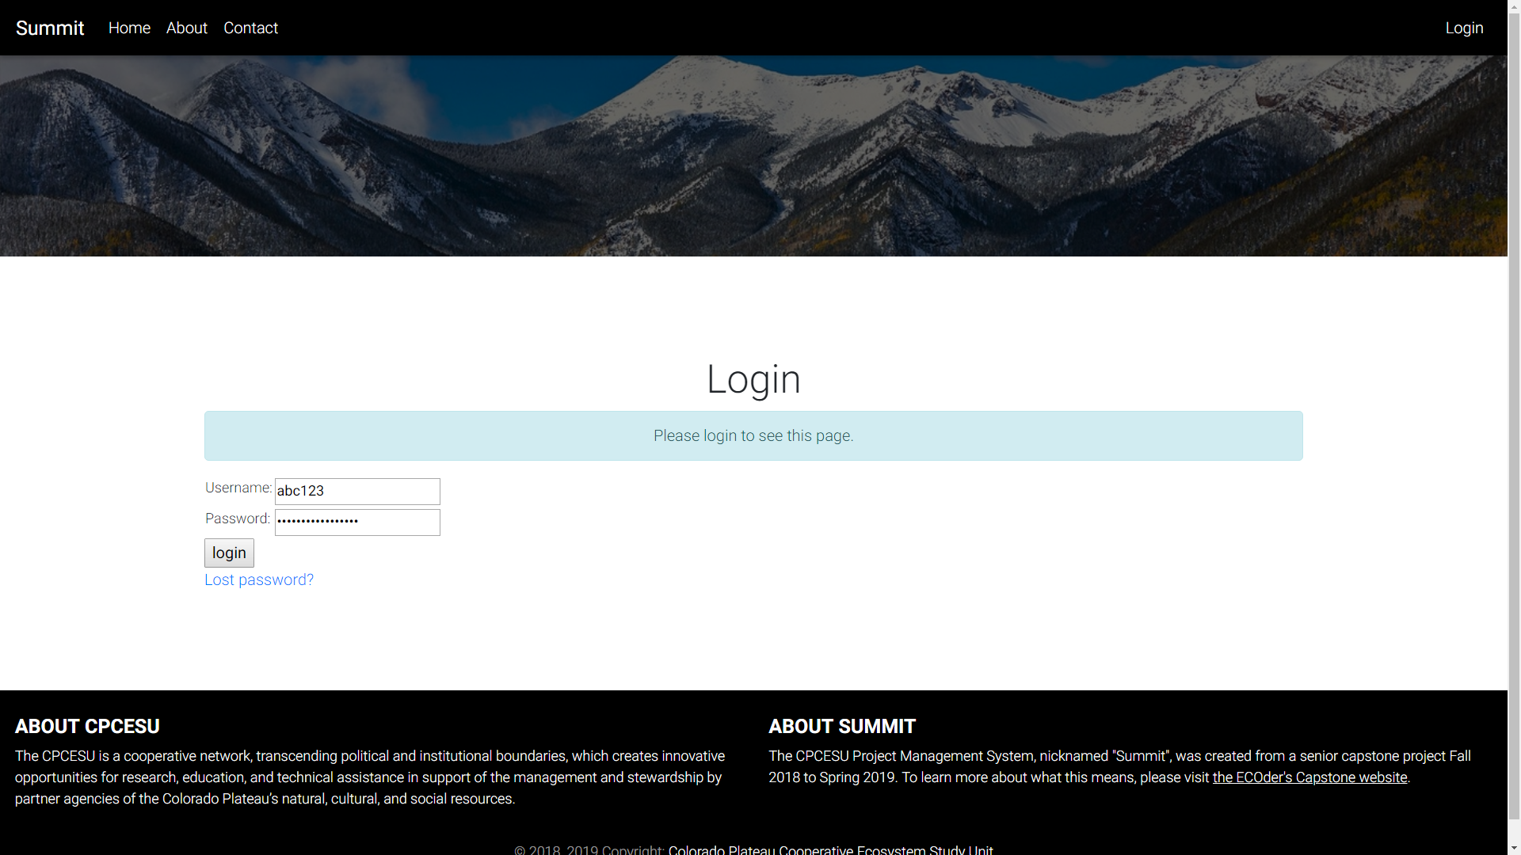
Current Status - Authentication
Notes:
[Jasque]
Federal computers

Slide 30
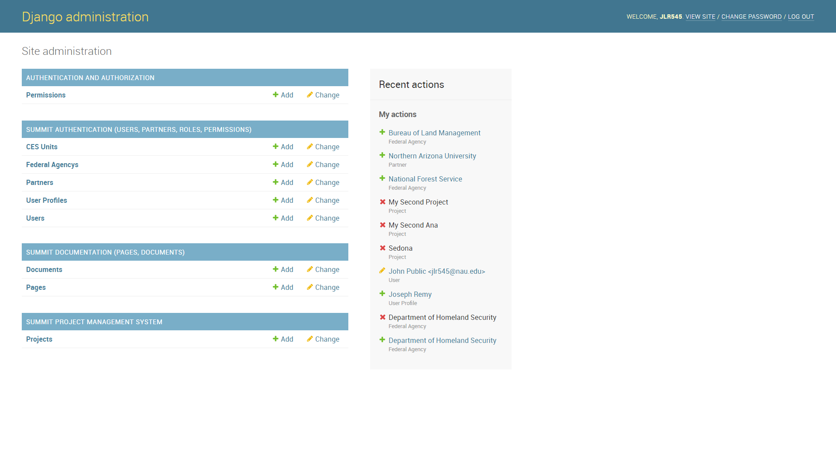
Current Status - Django’s Admin Site
Notes:
[Jasque]
Federal computers

